Slide 1
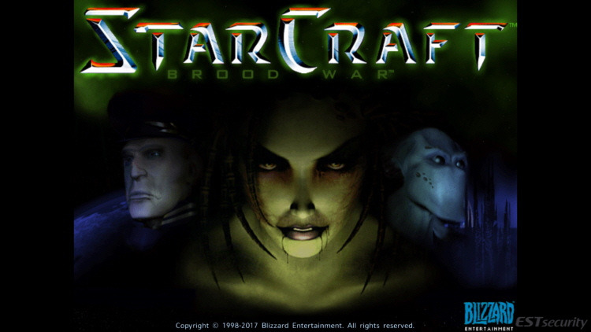
4/11/2022, Byeongchan Gwak

Slide 2
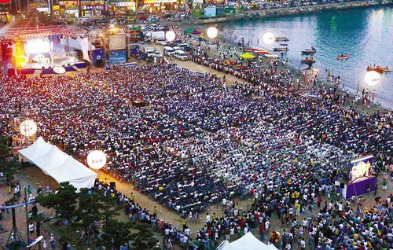
Can you guess what this image is?

Slide 3
The Starcraft Finals in 2004
Almost 100,000 Audience

Slide 4
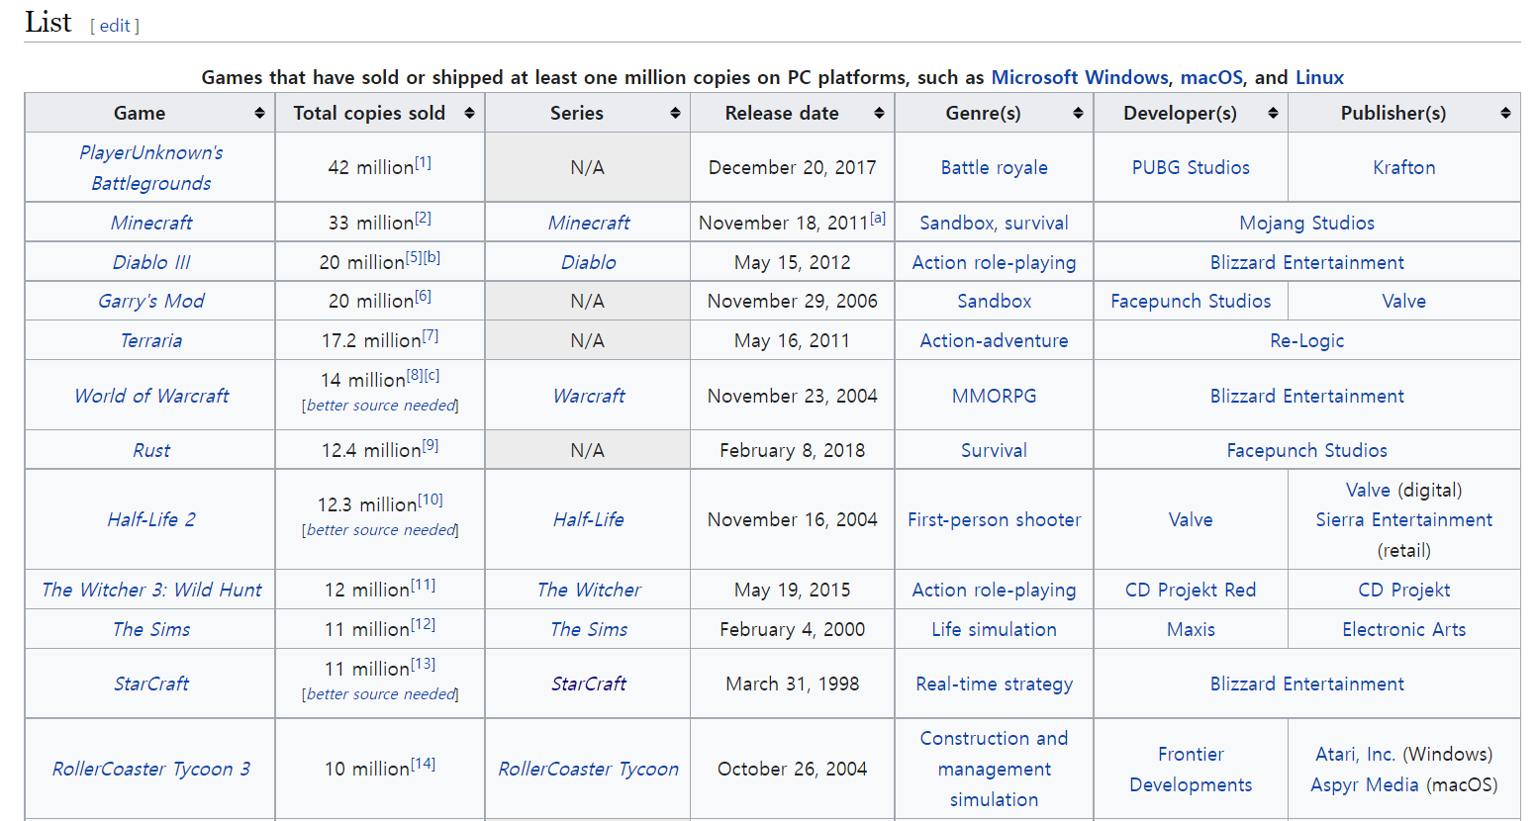
best-selling PC games

Slide 5
Success Factors
1. 3 races
2. More
Characters
3. Battle net
4. Use map

Slide 6

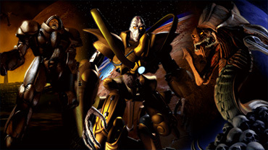
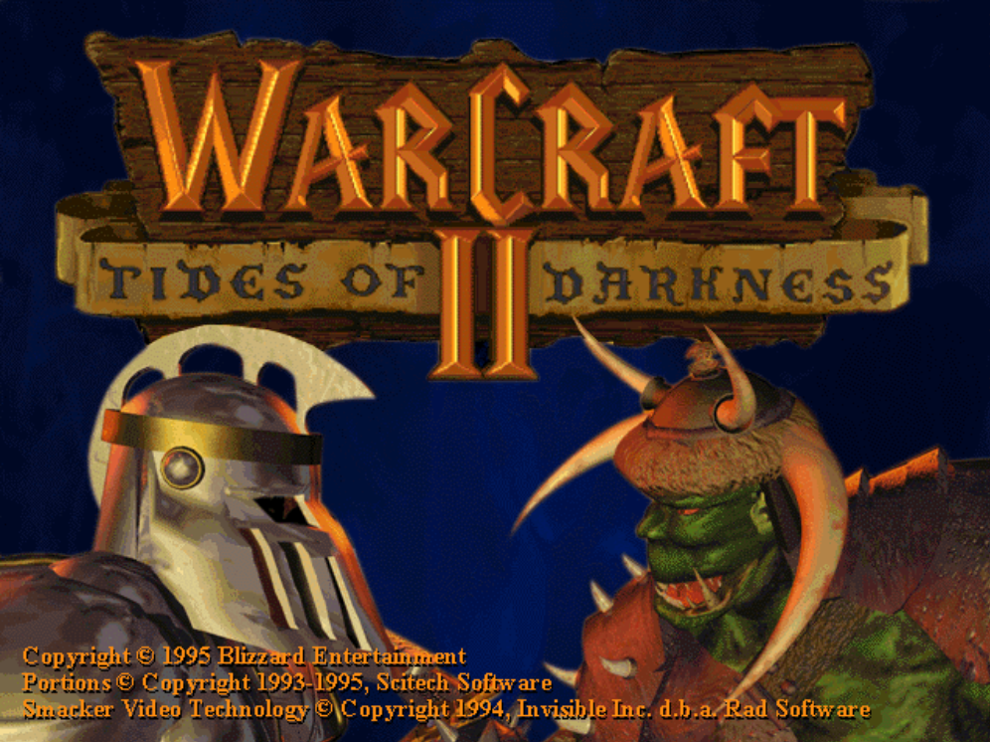
1. 3 races

Slide 7


2. More Characters

Slide 8
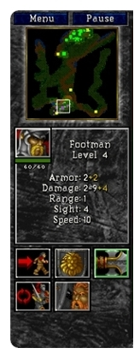
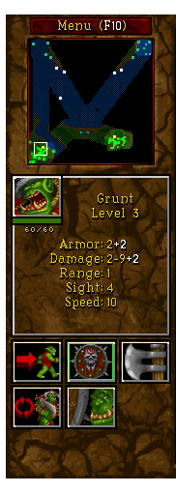
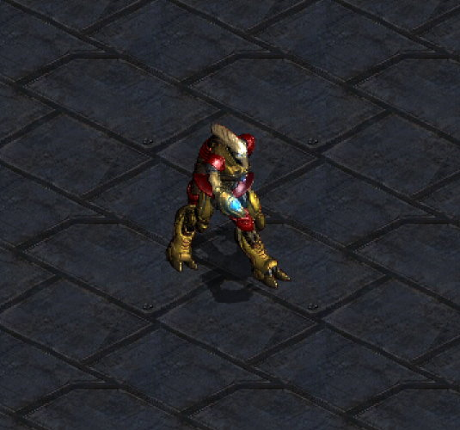
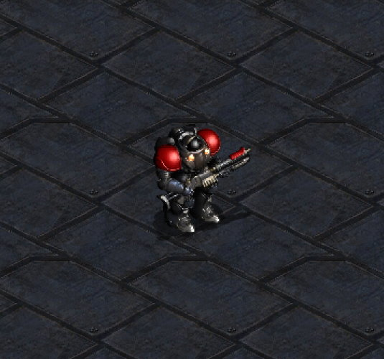
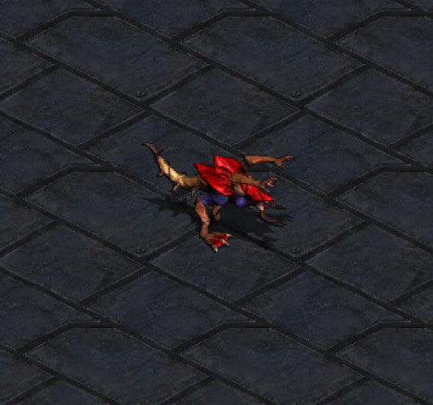
2. Characters + Balance
Notes:
Let me give you an example.
In warcraft 2, there are two races, one is human and the other is orc.
And their base unit are Footman and Grunt
And their attack method is the same. They do melee attack.
They need to approach to attack others.
But, in Starcraft, they are not the same.
They have unique base units.
Zealot and Zergling do melee attack,
Marine do ranged attack.
So, if you play terran and if you can do control well, and then you can win at early stage of the game.
Because marine can shoot others without approaching. You might not lose your precious marines.
Mismatch in attack style creates different tactics for players.
It is natural that more characters, the more difficult to make it balanced.
But this game did what seemed really difficult.
I think this is also important success factor of Starcraft.

Slide 9
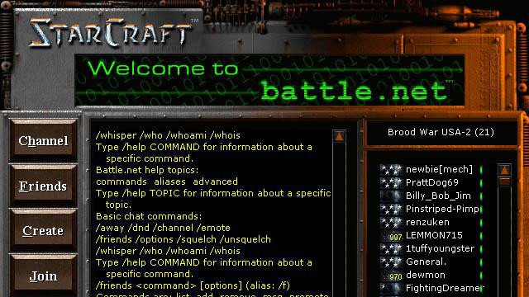
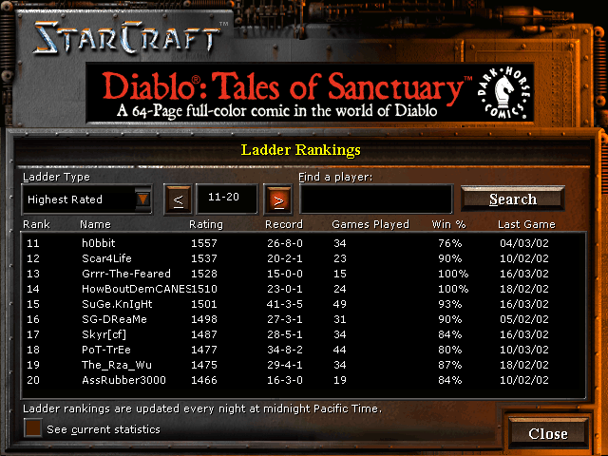
3. Battle net

Slide 10
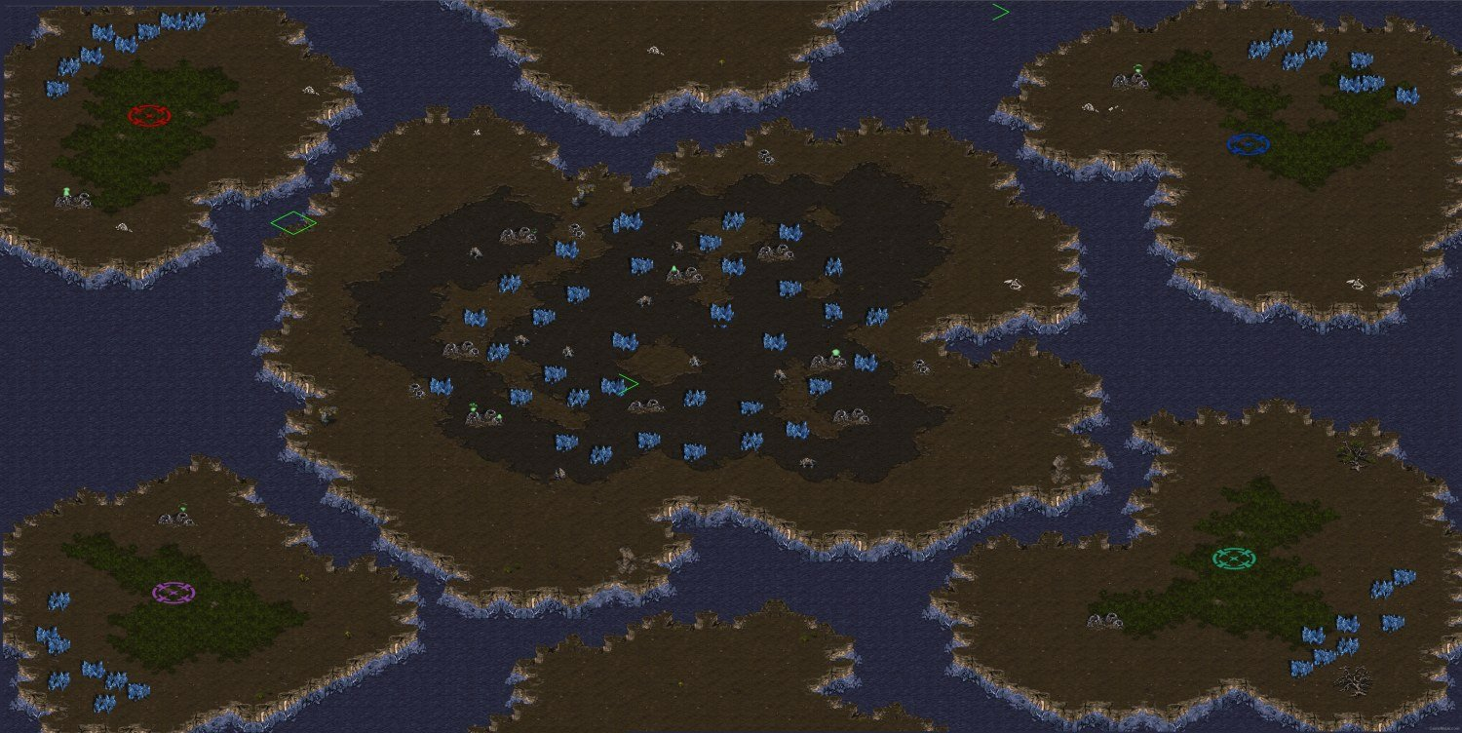
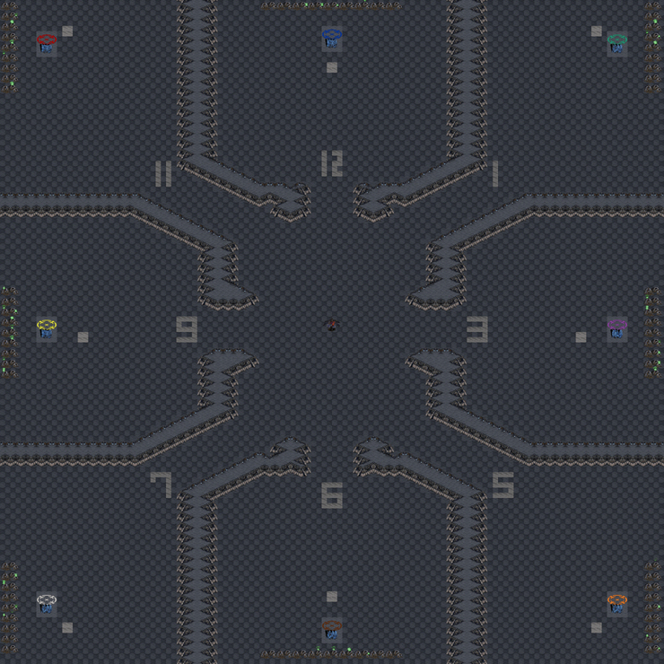
4. Use map

Slide 11
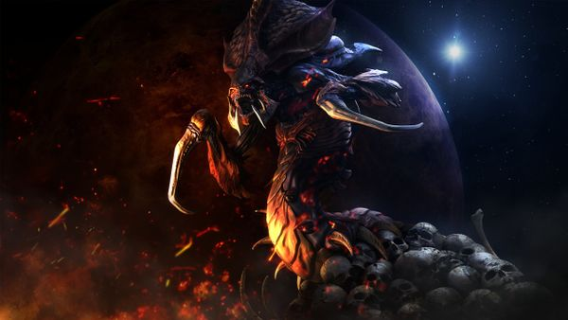
Sum up

Slide 12
6. References
https://en.wikipedia.org/wiki/List_of_best-selling_video_games
https://en.wikipedia.org/wiki/List_of_best-selling_PC_games
https://m.blog.naver.com/PostView.naver?isHttpsRedirect=true&blogId=redles&logNo=220744573124
https://www.gamemaps.com/scbw/

Slide 13

Thanks for listening

